Slide 1
ChassisInfoFetcher Installation guide
Alexandru Smeureanu

Slide 2

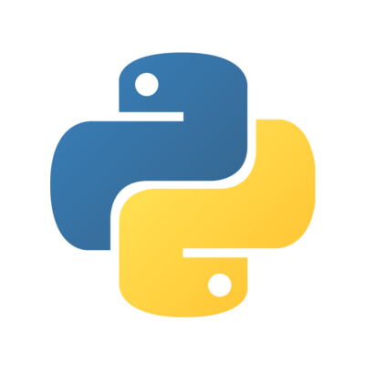

Installation methods
PyPI (pip)
Using Docker containers
easy deployment
less dependencies problems
Using pip & installer package
dependencies install automatically
follows PyPi guidelines
little user interaction during install
Using sources internal repo.
dependencies installed
manually
enhanced flexibility
easy access to code

Slide 3
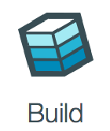
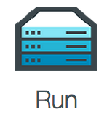
Installation using Docker
Downloading the Dockerfile build instructions
wget https://git.juniper.net/asmeureanu/ChassisInfoFetcher/raw/master/docker/Dockerfile
Building the Docker image
docker build -t juniper/chassisinfofetcher .
Running the application inside a container
docker run -i -t juniper/chassisinfofetcher /bin/ash -c "cd ChassisInfoFetcher;/usr/bin/python2.7 app.py"
Start a container in shell mode (manual application run)
docker build -t juniper/chassisinfofetcher .

Slide 4


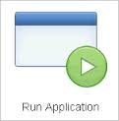
Installation using Pip
Downloading the application
wget https://git.juniper.net/asmeureanu/ChassisInfoFetcher/raw
/master/installer/bin/ChassisInfoFecher-latest-py2.py3-none-any.whl
Install the application
pip install ChassisInfoFetcher-latest-py2.py3-none-any.whl
Running the application
ChassisInfoFetcher

Slide 5

Installation using source from GitLab (later GitHub)
Install PyEz
pip install junos-eznc
Install urwid
pip install urwid
Install SpaceEz
Dependencies
git clone https://github.com/Juniper/py-space-platform.git
sudo pip install ./py-space-platform
Installing the application
git clone https://git.juniper.net/asmeureanu/ChassisInfoFetcher.git
Running the application
cd ChassisInfoFetcher; python app.py

